Slide 1
Mathematical Economics
Lecture 14

Slide 2
Plan
Convex sets
Separation theorems
Fixed point theorems

Slide 3



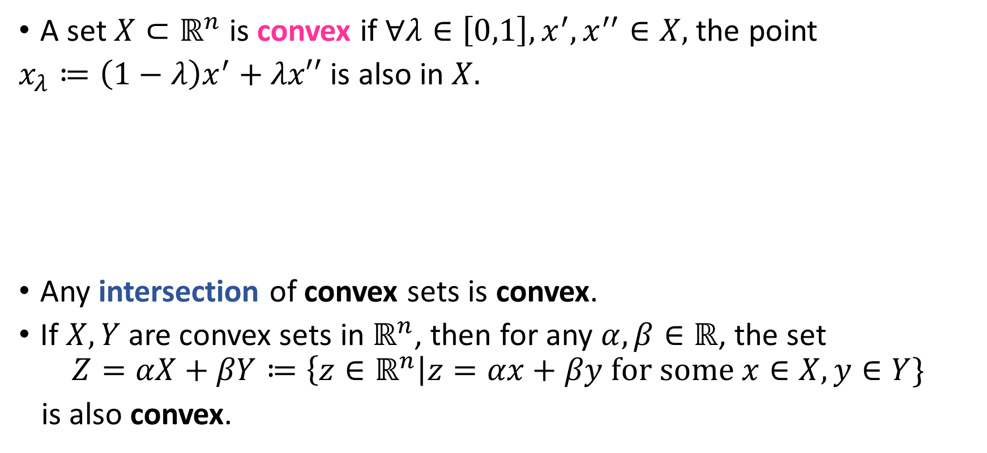

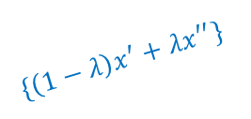



Convex Sets
A set $X⊂ℝ^{n}$ is convex if $∀λ∈\left[0,1\right], x^{′},x^{′′}∈X,$ the point
$x_{λ}≔\left(1−λ\right)x^{′}+λx′′$ is also in $X.$
Any intersection of convex sets is convex.
If $X,Y$ are convex sets in $ℝ^{n}$, then for any $α,β∈ℝ$, the set
$$Z=αX+βY≔\left\{z∈ℝ^{n}\right|z=αx+βy for some x∈X,y∈Y\}$$
is also convex.
$$x^{′′}$$
$$x^{′}$$
$$x^{′}$$
$$\{1/2x^{′}+1/2x^{′′}\}$$
$\{\left(1−λ\right)x^{′}+λx^{′′}\}$
Convex set
Non convex set
$$X$$
$$X$$
$$x^{′′}$$

Slide 4
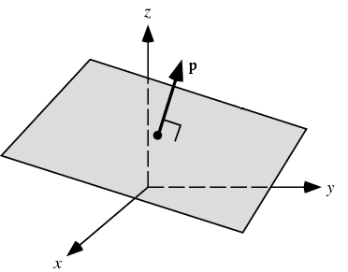
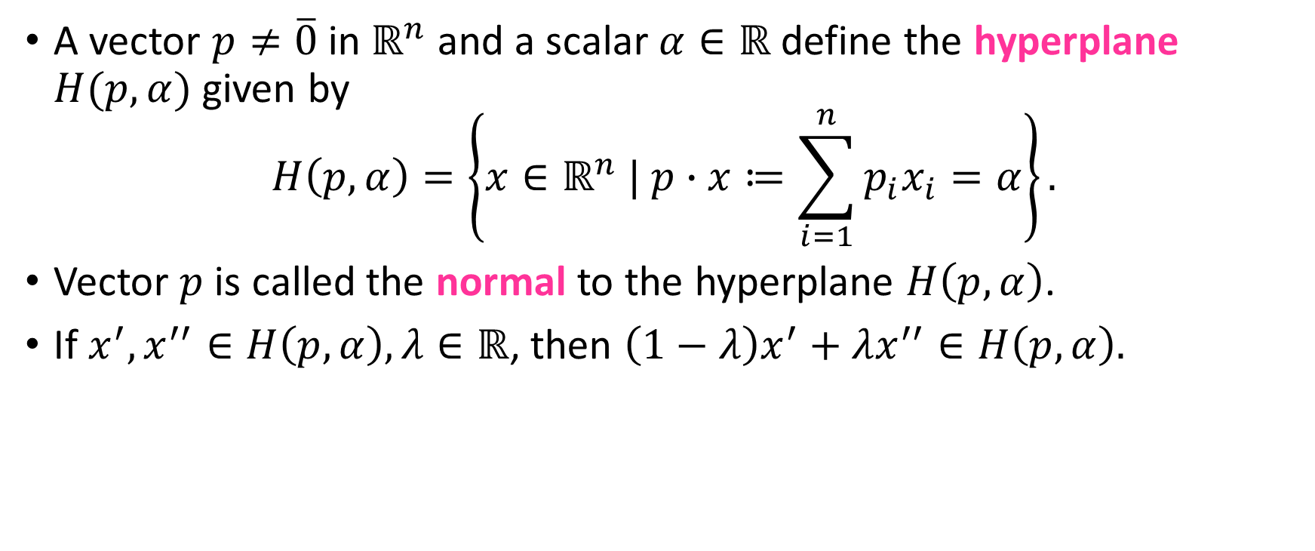
Hyperplane
A vector $p≠\overline{0}$ in $ℝ^{n}$ and a scalar $α∈ℝ$ define the hyperplane $H(p,α)$ given by
$$H\left(p,α\right)=\left\{x∈ℝ^{n} | p∙x≔\sum_{i=1}^{n}{p_{i}x_{i}=α}\right\}.$$
Vector $p$ is called the normal to the hyperplane $H\left(p,α\right)$.
If $x^{′},x^{′′}∈H\left(p,α\right),λ∈ℝ$, then $\left(1−λ\right)x^{′}+λx^{′′}∈H\left(p,α\right).$

Slide 5


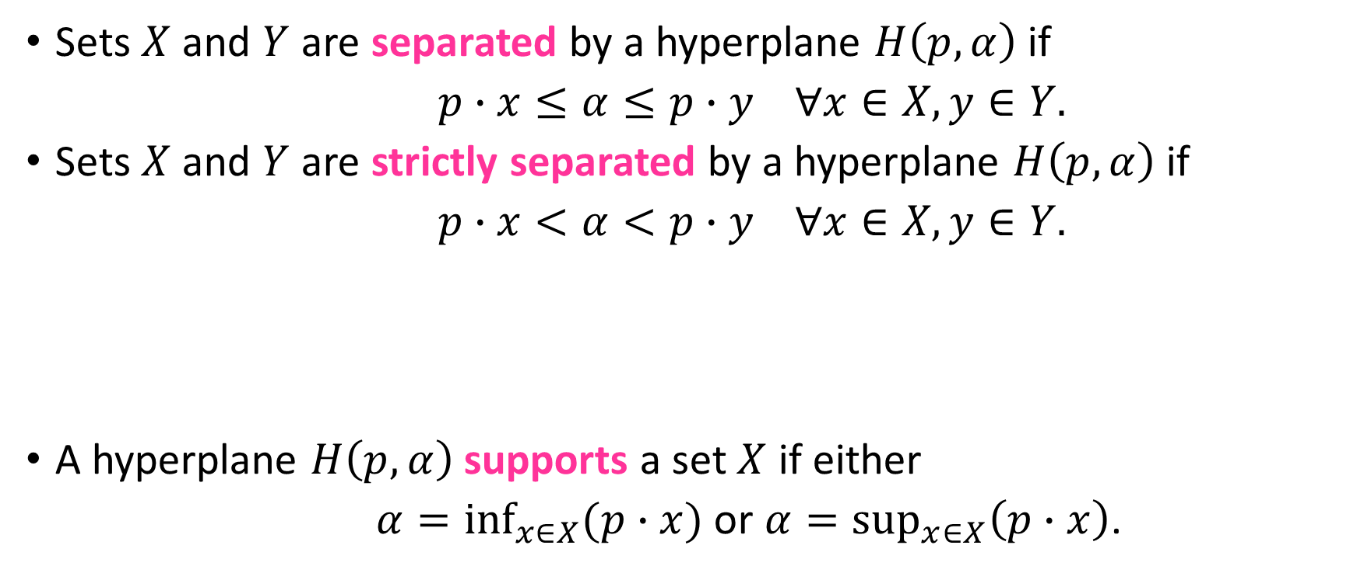



Separated Sets
Sets $X$ and $Y$ are separated by a hyperplane $H\left(p,α\right)$ if
$p∙x≤α≤p∙y ∀x∈X,y∈Y.$
Sets $X$ and $Y$ are strictly separated by a hyperplane $H\left(p,α\right)$ if
$p∙x<α<p∙y ∀x∈X,y∈Y.$
A hyperplane $H\left(p,α\right)$ supports a set $X$ if either
$α=\inf_{x∈X}(p∙x)$ or $α=\sup_{x∈X}\left(p∙x\right)$.
strictly separates
$$Y$$
$$Y$$
$$X$$
$$X$$
separates
supports
$$X$$
supports

Slide 6
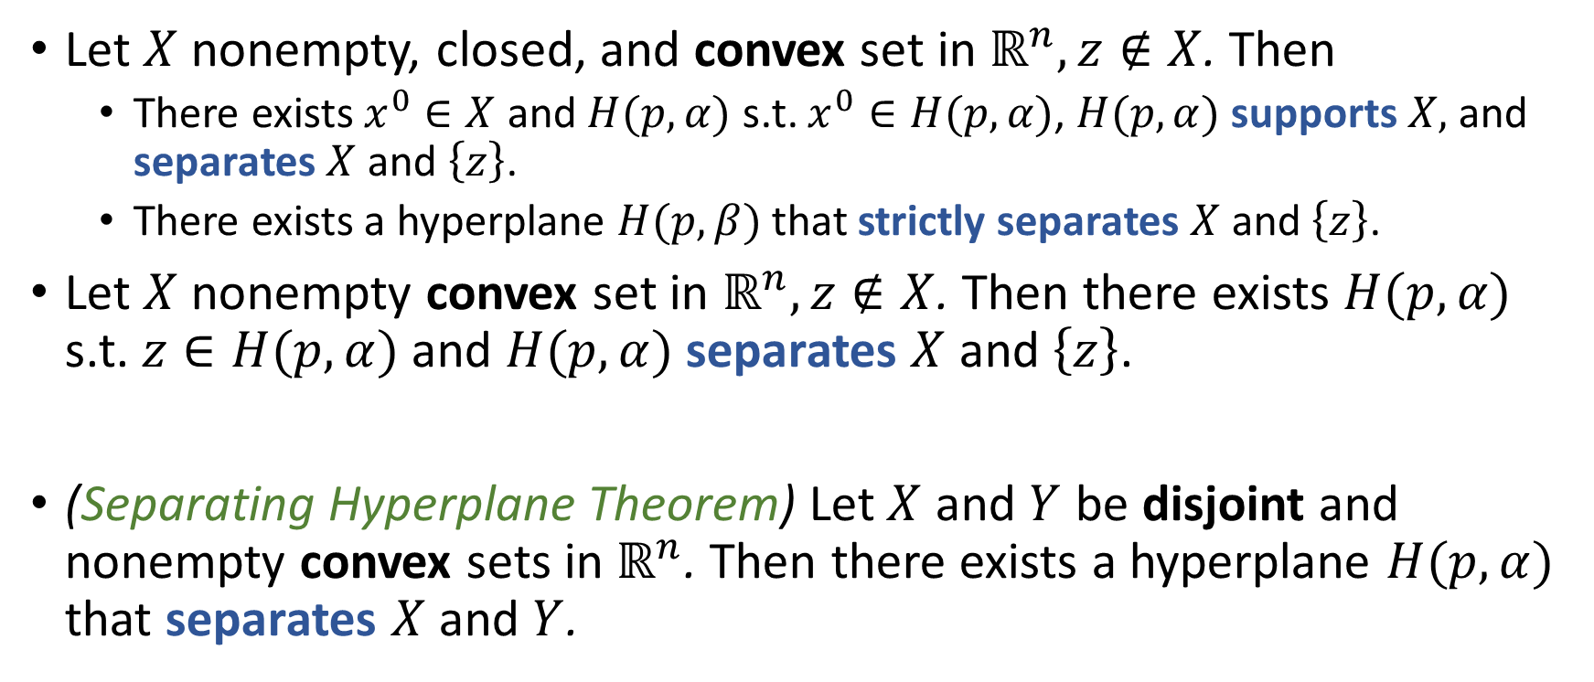
Separation Theorems
Let $X$ nonempty, closed, and convex set in $ℝ^{n}, z∉X$. Then
There exists $x^{0}∈X$ and $H(p,α)$ s.t. $x^{0}∈H(p,α)$, $H(p,α)$ supports $X,$ and separates $X$ and $\left\{z\right\}$.
There exists a hyperplane $H(p,β)$ that strictly separates $X$ and $\left\{z\right\}$.
Let $X$ nonempty convex set in $ℝ^{n}, z∉X$. Then there exists $H(p,α)$ s.t. $z∈H(p,α)$ and $H(p,α)$ separates $X$ and $\left\{z\right\}$.
(Separating Hyperplane Theorem) Let $X$ and $Y$ be disjoint and nonempty convex sets in $ℝ^{n}$. Then there exists a hyperplane $H(p,α)$ that separates $X$ and $Y$.

Slide 7











Separation Theorems: Illustrations
· Separate a set and a point: · Separate two sets:
$H(p,β)$
$H(p,α)$
$$z$$
$H(p,α)$
$$p$$
$$Y$$
$$x^{0}$$
$$X$$
$$X$$
$$Y$$
· Non-convex sets are not always
separable
$$X$$

Slide 8



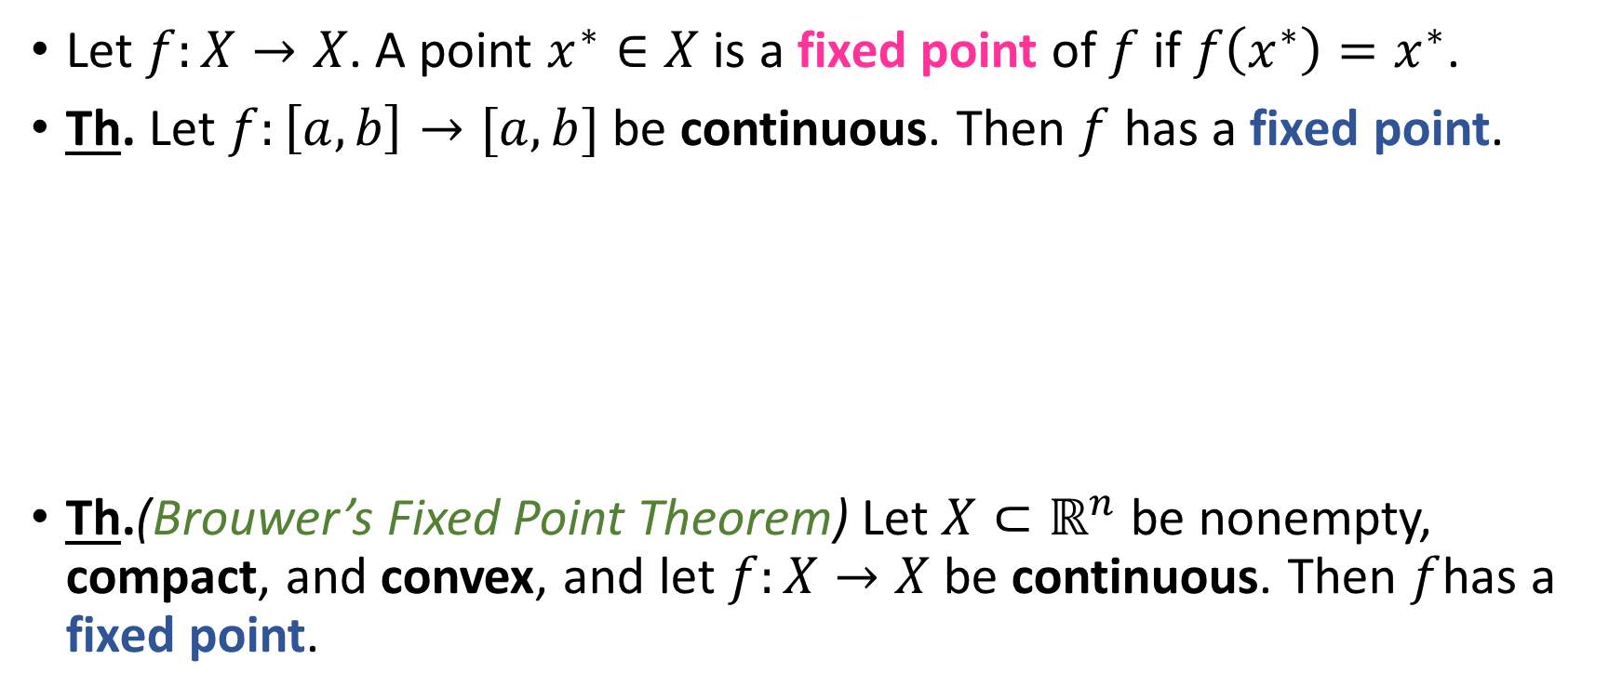




Fixed Point Theorems
Let $f:X→X$. A point $x^{∗}∈X$ is a fixed point of $f$ if $f\left(x^{∗}\right)=x^{∗}$.
Th. Let $f:\left[a,b\right]→[a,b]$ be continuous. Then $f$ has a fixed point.
Th.(Brouwer’s Fixed Point Theorem) Let $X⊂ℝ^{n}$ be nonempty, compact, and convex, and let $f:X→X$ be continuous. Then $f$has a fixed point.
$$b$$
$$x^{∗}$$
$$f(x)$$
$$a$$
$$x$$
$$a$$
$$b$$

